Slide 1


REST Services and AJAX
HTTP, RESTful Web Services, AJAX Concepts, XMLHttpRequest
SoftUni Team
Technical Trainers
Software University
http://softuni.bg

Slide 2
Table of Contents
The HTTP Overview
HTTP Developer Tools
REST and RESTful Services
Accessing the GitHub API
AJAX
Fetch API

Slide 3
Have a Question?
sli.do #JS-CORE

Slide 4

HTTP Overview
HTTP Protocol

Slide 5



HTTP Basics
HTTP (Hyper Text Transfer Protocol)
Text-based client-server protocol for the Internet
For transferring Web resources (HTML files, images, styles, etc.)
Request-response based
HTTP request
HTTP response
Web Client
Web Server

Slide 6






HTTP Request Methods
HTTP defines methods to indicate the desired action to be performed on the identified resource
Method | Description
GET | Retrieve / load a resource
POST | Create / store a resource
PUT | Update a resource
DELETE | Delete (remove) a resource
PATCH | Update resource partially
HEAD | Retrieve the resource's headers
OPTIONS | Returns the HTTP methods that the server supports for the specified URL

Slide 7
HTTP GET Request - Example
GET /users/testnakov/repos HTTP/1.1
Host: api.github.com
Accept: */*
Accept-Language: en
Accept-Encoding: gzip, deflate
User-Agent: Mozilla/5.0 (Windows NT 10.0; WOW64) AppleWebKit/537.36 (KHTML, like Gecko) Chrome/54.0.2840.71 Safari/537.36
Connection: Keep-Alive
Cache-Control: no-cache
<CRLF>
HTTP request line
HTTP headers
The request body is empty

Slide 8
HTTP POST Request - Example
POST /repos/testnakov/test-nakov-repo/issues HTTP/1.1
Host: api.github.com
Accept: */*
Accept-Language: en
Accept-Encoding: gzip, deflate
User-Agent: Mozilla/4.0 (compatible;MSIE 6.0; Windows NT 5.0)
Connection: Keep-Alive
Cache-Control: no-cache
<CRLF>
{"title":"Found a bug",
"body":"I'm having a problem with this.",
"labels":["bug","minor"]}
<CRLF>
HTTP request line
HTTP headers
The request body holds the submitted data

Slide 9
HTTP Response - Example
HTTP/1.1 200 OK
Date: Fri, 11 Nov 2016 16:09:18 GMT+2
Server: Apache/2.2.14 (Linux)
Accept-Ranges: bytes
Content-Length: 84
Content-Type: text/html
<CRLF>
<html>
<head><title>Test</title></head>
<body>Test HTML page.</body>
</html>
HTTP response status line
HTTP response headers
HTTP response body

Slide 10
HTTP Response Status Codes
Status Code | Action | Description
200 | OK | Successfully retrieved resource
201 | Created | A new resource was created
204 | No Content | Request has nothing to return
301 / 302 | Moved | Moved to another location (redirect)
400 | Bad Request | Invalid request / syntax error
401 / 403 | Unauthorized | Authentication failed / Access denied
404 | Not Found | Invalid resource
409 | Conflict | Conflict was detected, e.g. duplicated email
500 / 503 | Server Error | Internal server error / Service unavailable

Slide 11
Content-Type and Disposition
The Content-Type / Content-Disposition headers specify how the HTTP request / response body should be processed
JSON-encoded data
Content-Type: application/json
UTF-8 encoded HTML page. Will be shown in the browser
Content-Type: text/html; charset=utf-8
Content-Type: application/pdf
Content-Disposition: attachment; filename="Financial-Report-April-2016.pdf"
This will download a PDF file named Financial-Report-April-2016.pdf

Slide 12

HTTP Developer Tools
Chrome Dev Tools, Fiddler, Postman

Slide 13
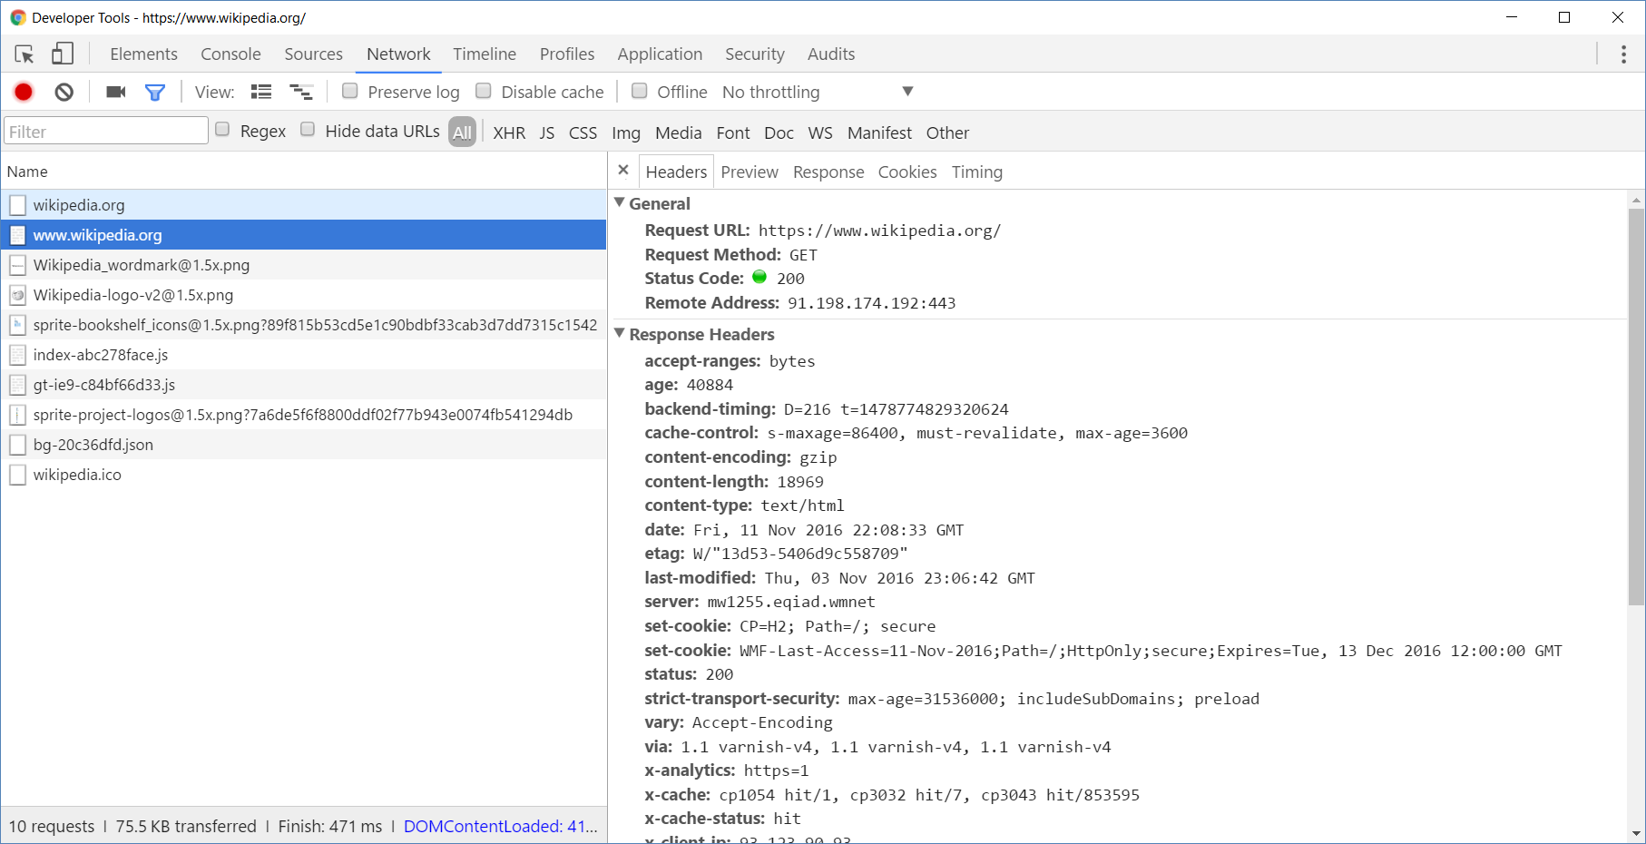
Chrome Developer Tools
Read more about Chrome Developer Tools

Slide 14
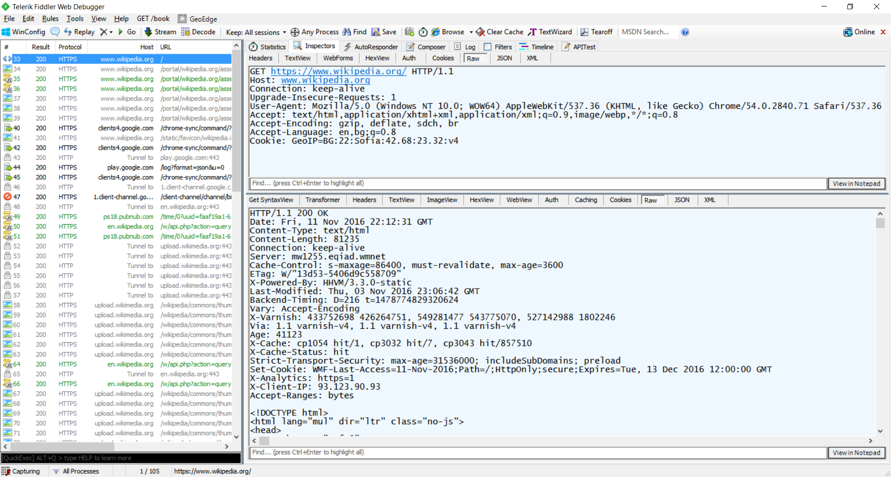
Fiddler
Read more about Fiddler

Slide 15
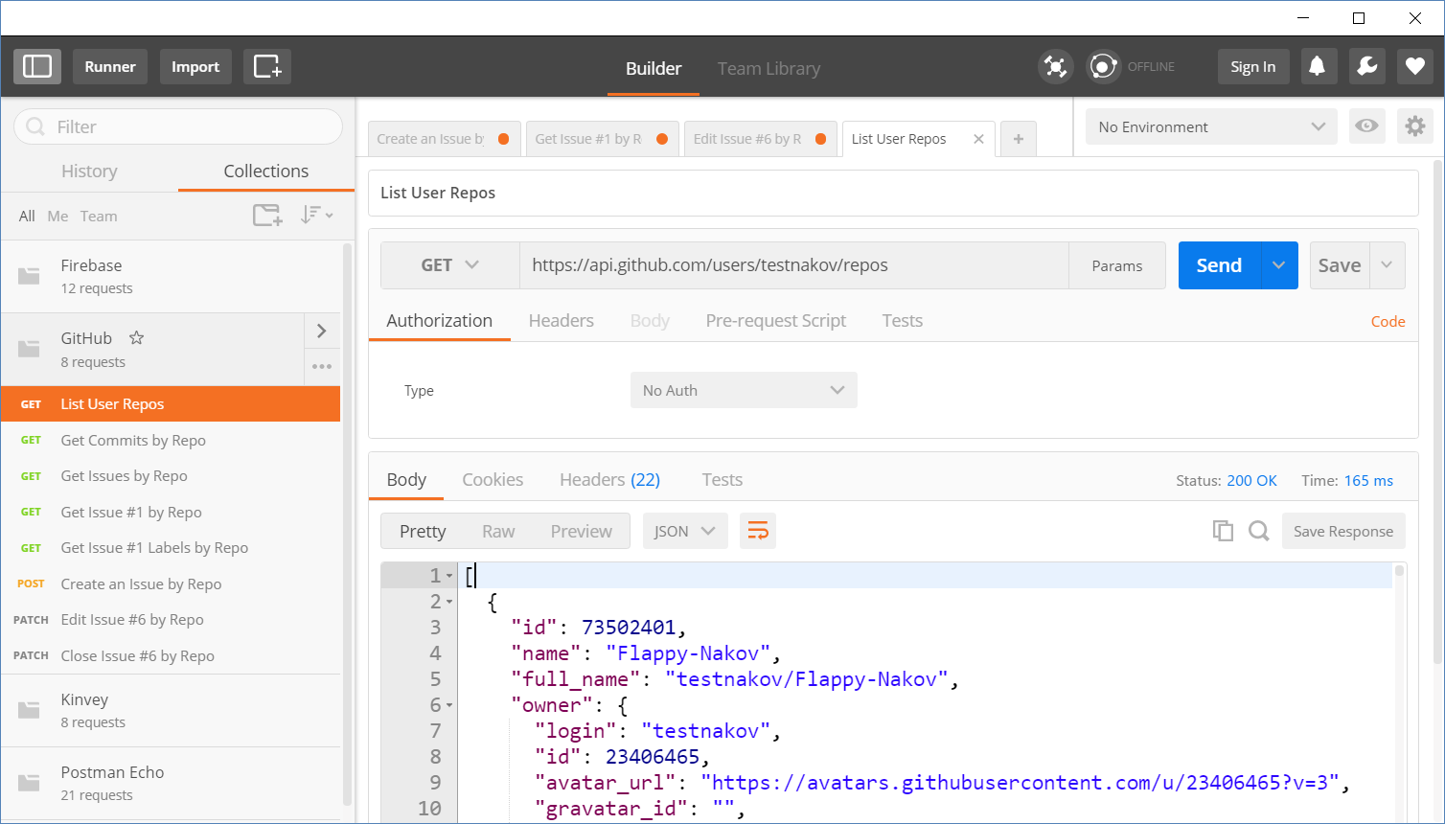
Postman
Read more about Postman REST Client

Slide 16
{REST}
REST and RESTful Services

Slide 17
REST and RESTful Services
Representational State Transfer (REST)
Architecture for client-server communication over HTTP
Resources have URI (address)
Can be created/retrieved/ modified/deleted/etc.
RESTful API/RESTful Service
Provides access to server-side resources via HTTP and REST
REST Web Service
URI
Resource
Representation 1
Representation 2
Representation 3
Representation 4
GET
PUT
POST
DELETE
Uniform Method

Slide 18

REST Architectural Constraints
REST defines 6 architectural constraints which make any web service - a true RESTful API
Client-server architecture
Statelessness
Cacheable
Layered system
Code on demand (optional)
Uniform interface
Read more about REST Architectural Constraints

Slide 19
Authentication vs. Authorization
Authentication
The process of verifying the identity of a user or computer
Questions: "Who are you?", "How you prove it? "
Credentials can be password, smart card, external token, etc.
Authorization
The process of determining what a user is permitted to do on a computer or network
Questions: " What are you allowed to do?", "Can you see this page?"

Slide 20
REST and RESTful Services - Example
Create a new post
Get all posts / specific post
Delete existing post
Replace / modify existing post
POST
http://some-service.org/api/posts
GET
http://some-service.org/api/posts
GET
http://some-service.org/api/posts/17
DELETE
http://some-service.org/api/posts/17
PUT/PATCH
http://some-service.org/api/posts/17

Slide 21

GitHub REST API
Accessing GitHub through HTTP

Slide 22
GitHub API
List user's all public repositories:
Get all commits from a public repository:
Get all issues/issue #1 from a public repository
GET
https://api.github.com/users/testnakov/repos
GET
https://api.github.com/repos/testnakov/softuniada-2016/commits
GET
/repos/testnakov/test-nakov-repo/issues
GET
/repos/testnakov/test-nakov-repo/issues/1

Slide 23

Github: Labels Issue
Get the first issue from the "test-nakov-repo" repository
Send a GET request to:
https://api.github.com/repos/testnakov/test-nakov-repo/ issues/:id
Where :id is the current issue

Slide 24
GitHub API (2)
Get all labels for certain issue from a public repository:
Create a new issue to certain repository (with authentication)
GET
https://api.github.com/repos/testnakov/test-nakov-repo/issues/1/labels
POST
https://api.github.com/repos/testnakov/test-nakov-repo/issues
Headers
Authorization: Basic base64(user:pass)
Body
{"title":"Found a bug",
"body": "I'm having a problem with this."}

Slide 25
Github: Create Issue
Create an issue when you send a "POST" request
Use your Github account credentials to submit the issue

Slide 26

A AX
AJAX
Asynchronous JavaScript and XML

Slide 27
What is AJAX?
Asynchronous JavaScript And XML
Background loading of dynamic content/data
Load data from the Web server and render it
Two types of AJAX
Partial page rendering
Load HTML fragment + show it in a <div>
JSON service
Load JSON object and display it with JS/jQuery

Slide 28

AJAX: Workflow
1. HTTP request (initial page load)
2. HTTP response (HTML page)
AJAX request
UI Interaction
AJAX response (asynchronous)
AJAX handler
Returns data as JSON / HTML
Web Client
Web Server
Modify the page DOM

Slide 29
AJAX request
AJAX response
Web Client
Web Server
Using the XMLHttpRequest Object

Slide 30
XMLHttpRequest - Standard API for AJAX
<button onclick="loadRepos()">Load Repos</button>
<div id="res"></div>
function loadRepos() {
const req = new XMLHttpRequest();
req.onreadystatechange = function() {
if (this.readyState == 4 && this.status == 200)
document.getElementById("res").textContent =
this.responseText;
};
req.open("GET",
"https://api.github.com/users/testnakov/repos", true);
req.send();
}

Slide 31
XHR (XmlHttpRequest)
Write a function, which:
Loads GitHub repository asynchronously with AJAX
Creates an instance of XHR and attach onreadystatechange event to it

Slide 32
What is Fetch?
The fetch() method allows making network requests
It is similar to XMLHttpRequest (XHR). The main difference is that the Fetch API:
Uses Promises
Enables a simpler and cleaner API
Avoids callback hell
fetch('./api/some.json')
.then(function(response) {…})
.catch(function(err) {…})

Slide 33
Basic Fetch Request
The response of a fetch() request is a Stream object
The reading of the stream happens asynchronously
When the json() method is called, a Promise is returned
The response status is checked (should be 200) before parsing the response as JSON
if (response.status !== 200) { return; }
response.json().then(function(data) { console.log(data)})

Slide 34
Chaining Promises
When working with a JSON API, you can:
Define the status and JSON parsing in separate functions
The functions return promises which can be chained
fetch('users.json')
.then(status)
.then(json)
.then(function(data) {…})
.catch(function(error) {…});

Slide 35
GET Request
Fetch API uses the GET method so that a direct call would be like this
fetch('https://swapi.co/api/people/4')
.then((response) => response.json())
.then((data) => console.log(JSON.stringify(data)))
.catch((error) => console.error(error))

Slide 36
POST Request
To make a POST request, we can set the method and body parameters in the fetch() options
fetch('/url', {
method: 'post',
headers: { 'Content-type': 'application/json' },
body: JSON.stringify(data),
})

Slide 37
Body Methods
clone() - create a clone of the response
json() - resolves the promise with JSON
redirect() - create new promise but with different URL
text() - resolves the promise with string

Slide 38
Headers Interface
Allows you to perform various actions on HTTP requests and response headers
These actions includes:
Retrieving
Setting
Adding to
Removing

Slide 39
Headers
A headers object has an associated header list, which is initially empty
It's a simple multi-map of names and values
const content = 'Hello World';
const myHeaders = new Headers();
myHeaders.set('Content-Type', 'text/plain');
myHeaders.set('Content-Length', content.length.toString());
myHeaders.set('X-Custom-Header', 'ProcessThisImmediately');
Adding/setting new pair

Slide 40
Headers Methods
append() - append a new value onto an existing header
set() - set a new value for an existing header
get() - returns a ByteString sequence of all the values with a given name
entries() - returns an iterator allowing to go through all key/value pairs contained in this object
delete() - deletes a header

Slide 41
Response Types
basic - normal, same origin response
cors - response was received from a valid cross-origin request
error - error network
opaque - Response for "no-cors" request to cross-origin resource

Slide 42
Body Methods (2)
opaqueredirect - the fetch request was made with redirect: "manual"
arrayBuffer() - return a promise that resolve with an ArrayBuffer
blob() - determinates with a Blob
formData() - return promise that determinate with FormData object

Slide 43
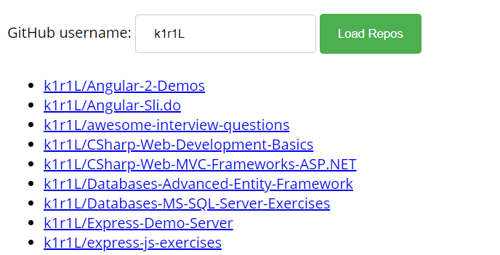
Problem: Load GitHub Repos with AJAX
GitHub username:
<input type="text" id="username" value="k1r1L" />
<button onclick="loadRepos()">Load Repos</button>
<ul id="repos"></ul>
function loadRepos() {
// AJAX call …
}

Slide 44
Solution: Load GitHub Repos with AJAX
function loadRepos() {
const repos = document.getElementById("repos");
repos.innerHTML = '';
const username = document.getElementById("username").value;
const url = `https://api.github.com/users/${username}/repos`;
fetch(url)
.then((response) => response.json())
.then((data) => displayRepos(data))
.catch((err) => displayError(err))
// Continues on the next slide...

Slide 45
Solution: Load GitHub Repos with AJAX (2)
function displayRepos(repos) {
for (let repo of repos) {
const link = document.createElement('a');
link.textContent = repo.full_name;
link.href = repo.html_url;
const listItem = document.createElement('li');
listItem.appendChild(link);
repos.appendChild(listItem)}
}
function displayError(err) { const listItem = document.createElement('li'); listItem.textContent = err;
repos.appendChild(listItem); }}

Slide 46

Live Exercises

Slide 47
Summary
…
…
…
HTTP is text-based request-response protocol
REST uses GET, POST, PUT, PATCH, DELETE
RESTful services address resources by URL
Provide CRUD operations over HTTP
AJAX background loading of dynamic content
XMLHttpRequest
Fetch

Slide 48
https://softuni.bg/courses/js-apps

Slide 49












SoftUni Diamond Partners

Slide 50




SoftUni Organizational Partners

Slide 51




Trainings @ Software University (SoftUni)
Software University – High-Quality Education and Employment Opportunities
softuni.bg
Software University Foundation
http://softuni.foundation/
Software University @ Facebook
facebook.com/SoftwareUniversity
Software University Forums
forum.softuni.bg

Slide 52

License
This course (slides, examples, demos, videos, homework, etc.) is licensed under the "Creative Commons Attribution-NonCommercial-ShareAlike 4.0 International" license

